Slide 1
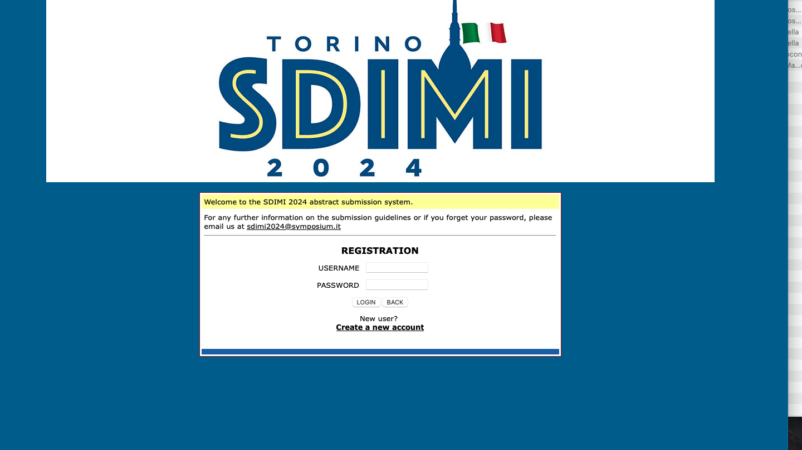
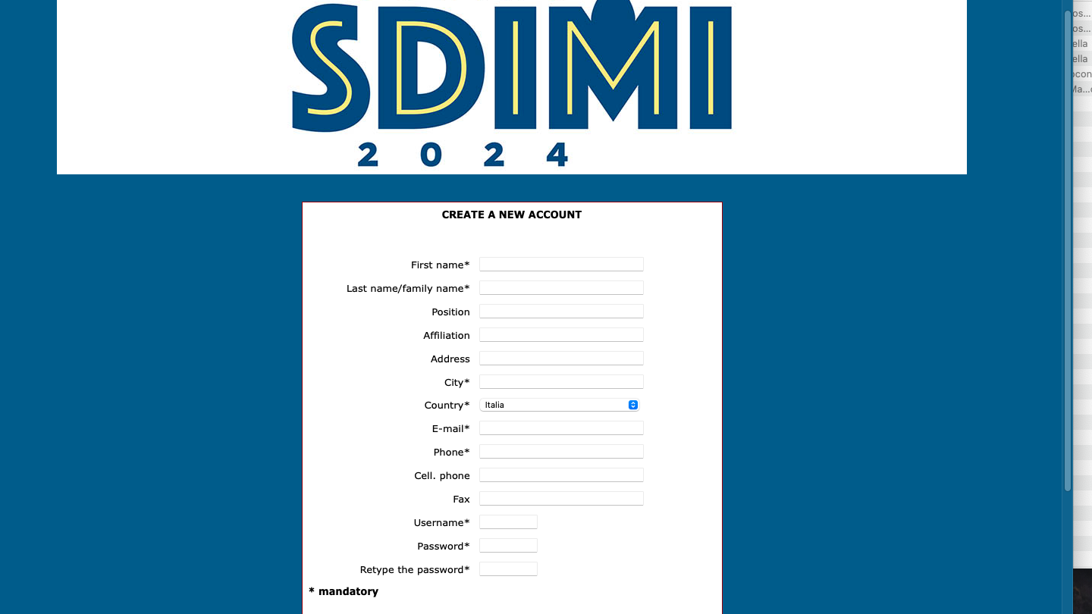
Please click here to create a new account

Slide 2
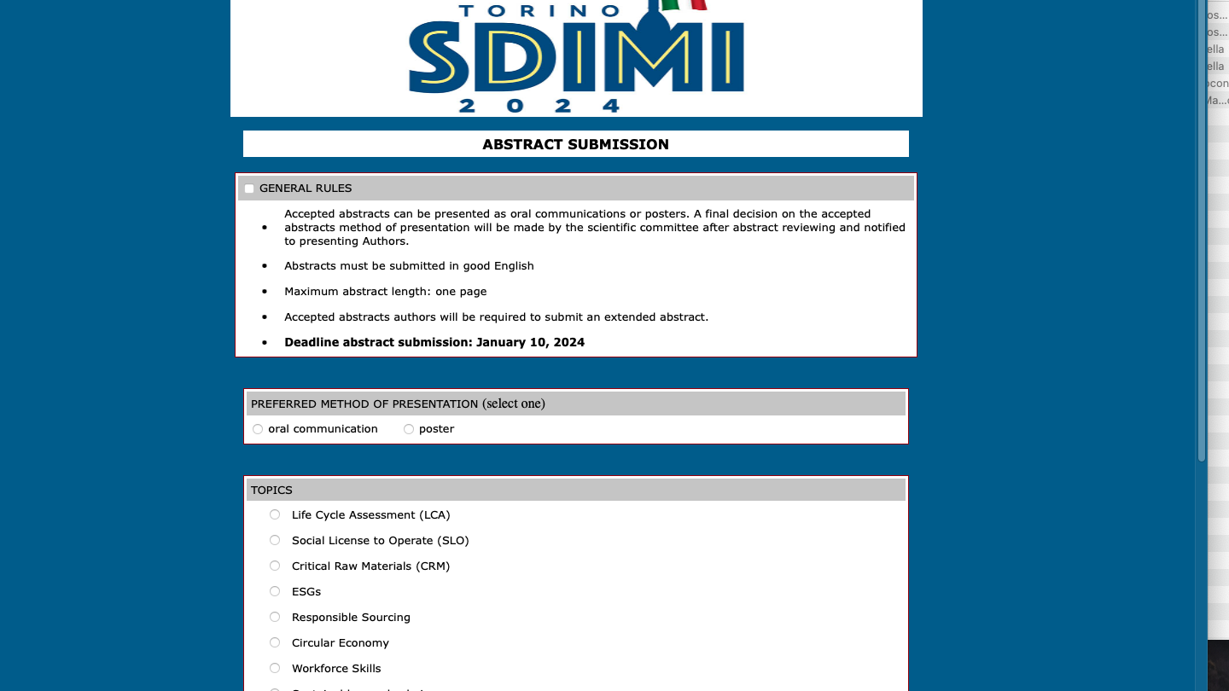
Please check and accept General Rules
Please select your preferred method of presentation and topic

Slide 3
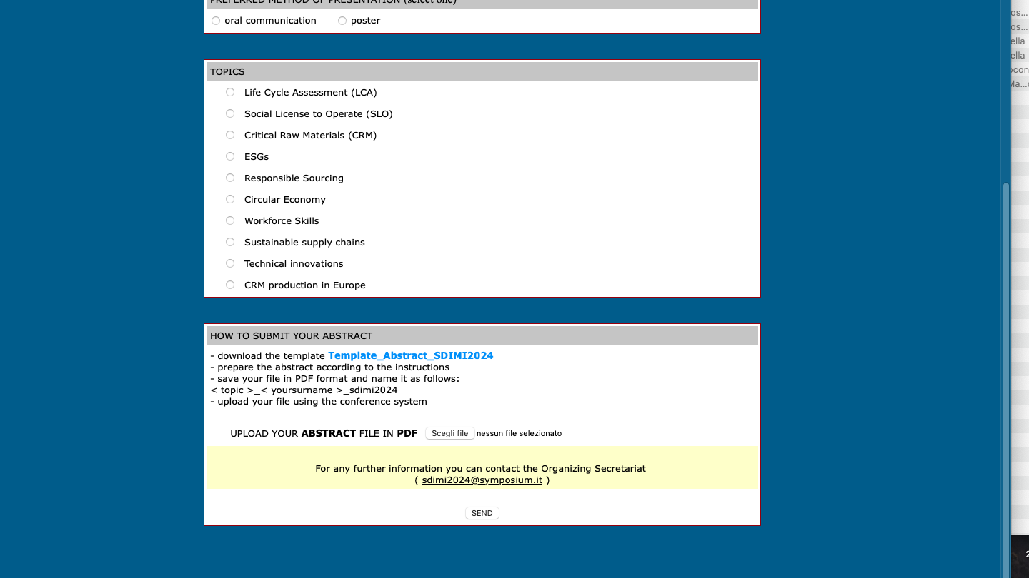
Please submit your abstract according to the following instructions

